Slide 1
IT-414
Software Project Management
Project Management Tools
GROUP - 3

Slide 2
Tool 1: Freedcamp
Freedcamp is a web-based project management tool and organization system for either single or multiple users.
Users are provided with some basic applications when they join initially, and they can then add additional features (free and paid) later on.
Also compatible with: Android, iOS (free applications available on playstore and app store)

Slide 3
Free applications:
Paid applications:
Tasks - Shared task lists with subtasks
Discussions - Forum boards
Milestones - Deadline setting
Calendar - Event scheduling
Time - Time tracking
Data Feed Link - We can link the data from different task and we can combine them and share them in public using link.
File Upload
Issue Tracker - Advanced workflow issue management
Gantt Charts - Visual way to see when tasks start and end as related to other tasks
Google Drive - Sync Freedcamp with your Google Drive
Dropbox - Integrate your Dropbox files inside of Freedcamp
Tasky - Private task list

Slide 4
Different roles that can be assigned:
Organiser- Can do everything but delete a project
Team Player- Full edit/delete access without ability to invite people or install apps
Contributor- Can only edit/delete tasks, comments, and other items created by them.
Observer- Can only view tasks, comments, and other items created by other users.

Slide 5
Installation process:
Sign Up : Go to the website and click on sign up button . On going to Sign up page you will be directed to register and login webpage. Create an account for free using Email ID and password.
Create the project: After completing the registering account you will get directed to “Create project” window.
Application modules installation: Applications are modules that provide certain functionality to your projects. To-dos, milestone, time and discussions are some of the modules that we can install and then choose which groups can access these.
Invite the team members for the projects using email ids and leaving a message about the current working project .

Slide 6
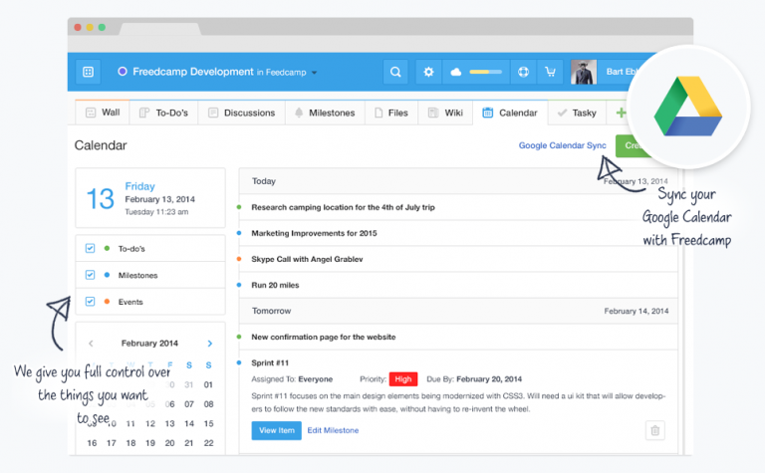
Overview:

Slide 7
Freedcamp:
This tools makes the work of the Project manager easy to track the time spent on project, deadlines, create to do lists and also share important document and information .
All communication can be done on mobile phones from any place and time using the feature of SMS, email, i.e every change during the project is automatically sent to project managers as instant, email or SMS notification. Managers can respond easily as well when they are away from work.

Slide 8
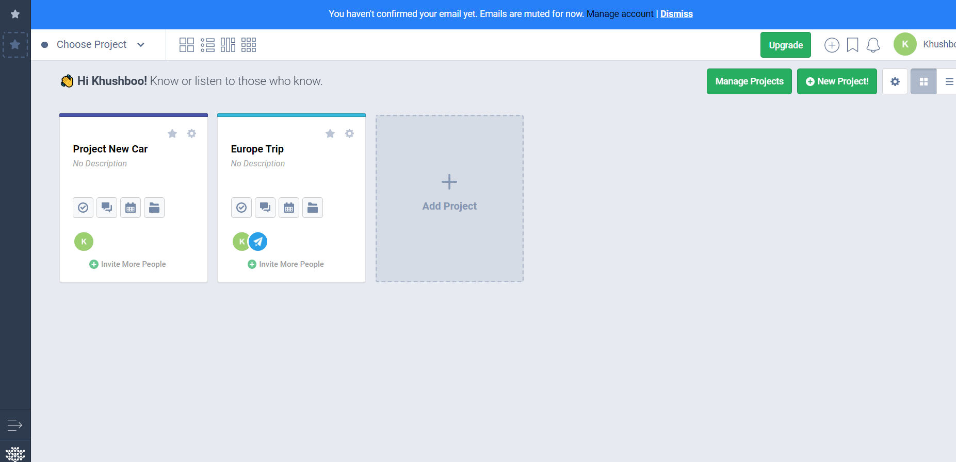
Dashboard:
defines the starting of project and also shows you the other projects.

Slide 9
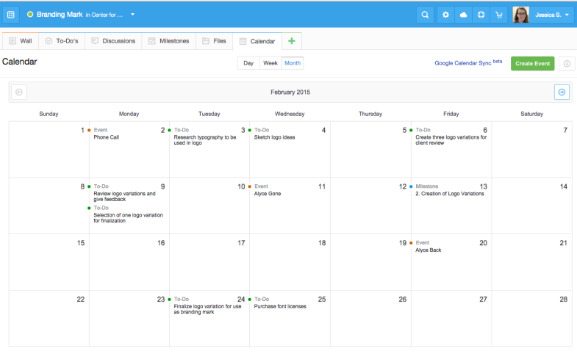
Calendar
This feature enables you to keep track of the work of the team.

Slide 10
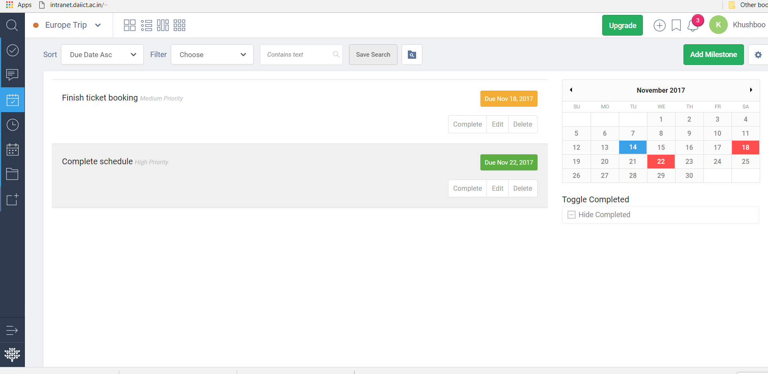
Tasks
One can manage the tasks using milestone and to-dos features of freedcamp tool.

Slide 11
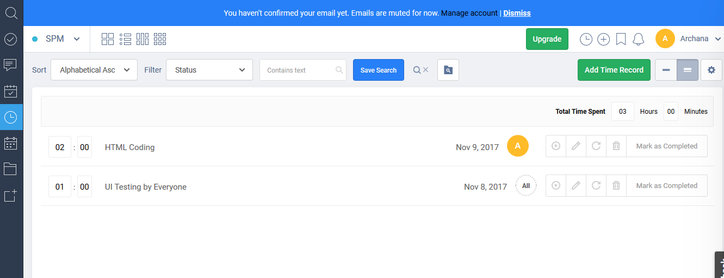
Keep catalog (Time)
This feature is used to keep track of your current work.

Slide 12
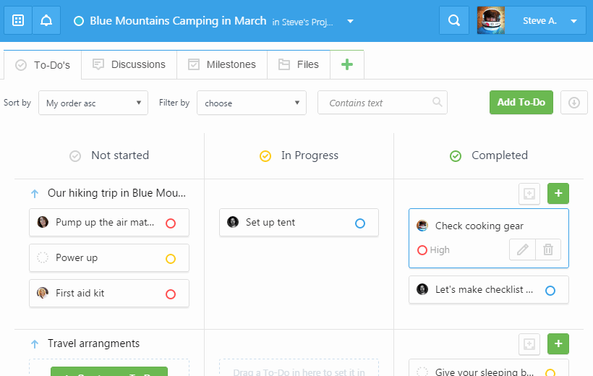
Schedule overview:

Slide 13
Pros and Cons
PROS:
Past projects can be used as a template for similar project saving precious time for dealing with more important issues within the project.
At a time multiple users can work on the tool.
There are notification updates whenever it gets new updates.
It is optimised for mobile user as well.
Has the property of auto save so you don’t need to worry about saving your work.
CONS:
A task can be assigned either to a single member, or to everyone only.
Some addons are quite expensive.
No Gantt chart.

Slide 14
Tool2 :- Open Project
Open Project is a free open source web application for project collaboration and managing projects at once place. Open project is a stand alone application for project planning.
It allows you to easily create, prioritize and assign tasks.
It provides open source platform, customization and configuration for project management tools.
OpenProject is developed using Angularjs and Ruby-Rails programming languages.
Team openproject has also shared their code on the open source platform github and invites collaborators for contributing.

Slide 15
Features :-
Overview
Roadmap
WorkPackages
Bug Backlogs
5) Budget
6) Cost Report
7) Project Setting
8) Gantt Chart

Slide 16
Different roles:
Project Admin: A project can have multiple admins, and each admin can basically manage the projects, users, groups, workflow.
Member: Can only edit/delete tasks, comments, and other items created by them.
Reader: Can only view tasks, comments, and other items created by other users.

Slide 17
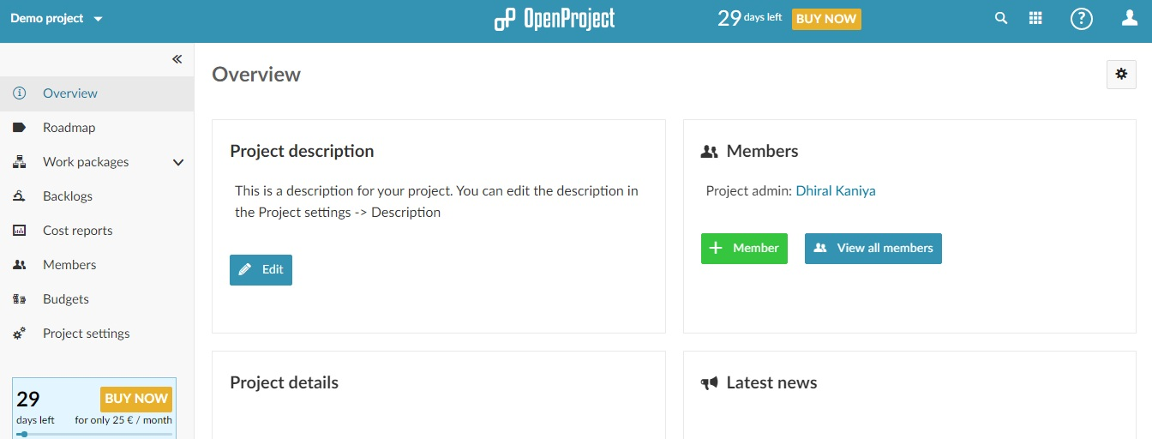
Overview

Slide 18
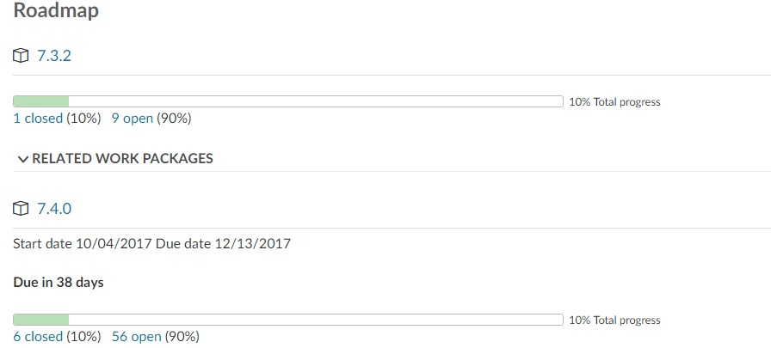
2) Roadmap
This view provides information on the project’s progress by displaying the percentage of closed vs. open work packages. Basically active roadmap can be considered as success key of the project

Slide 19
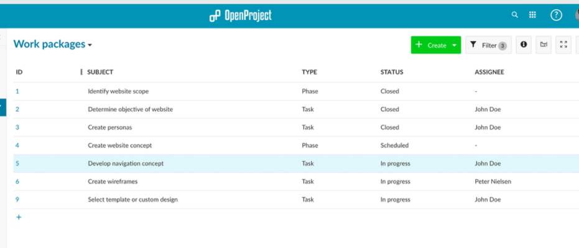
3) Work Packages
Work Packages is all about the work that has been assigned to the members.
In addition to that, it covers summary of the task, bugs, phases, timeline and user stories that helps to manage task distribution at one place.

Slide 20
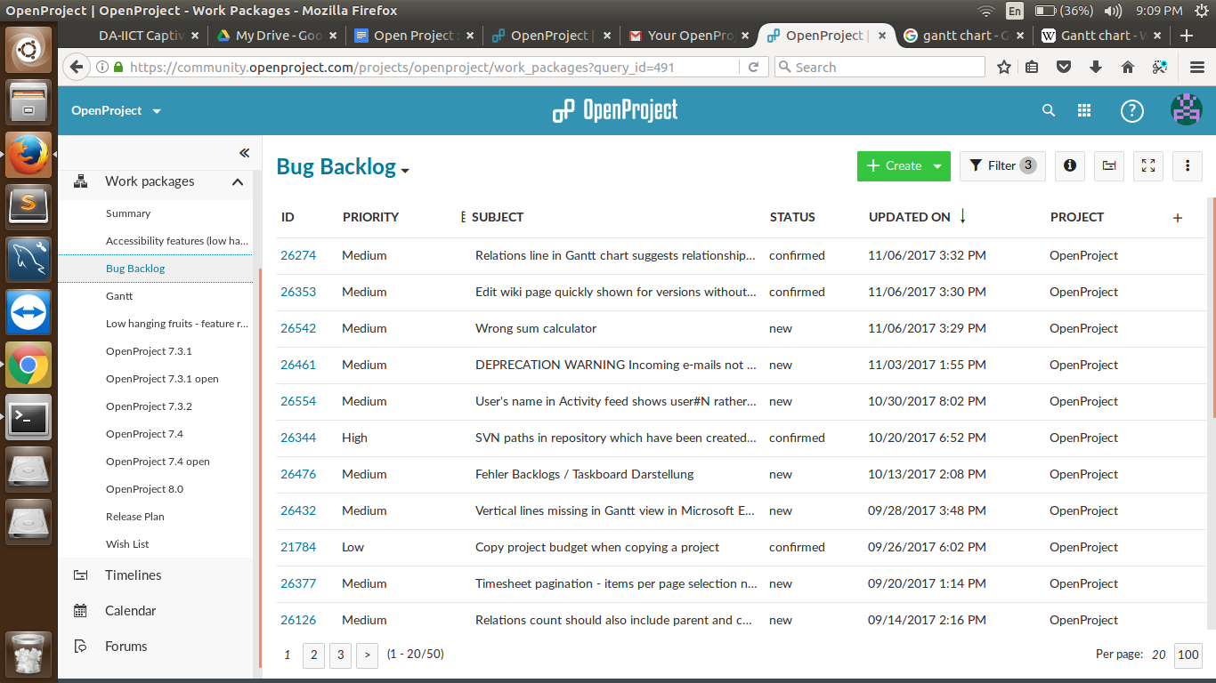
4) Bug Backlogs

Slide 21
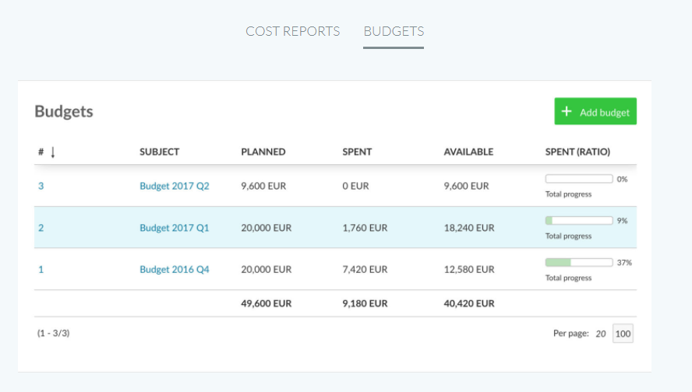
5) Budget

Slide 22
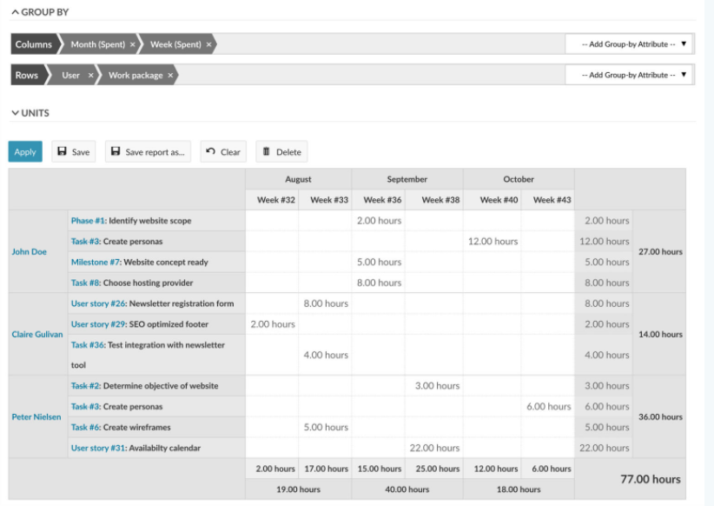
6) Cost Report

Slide 23
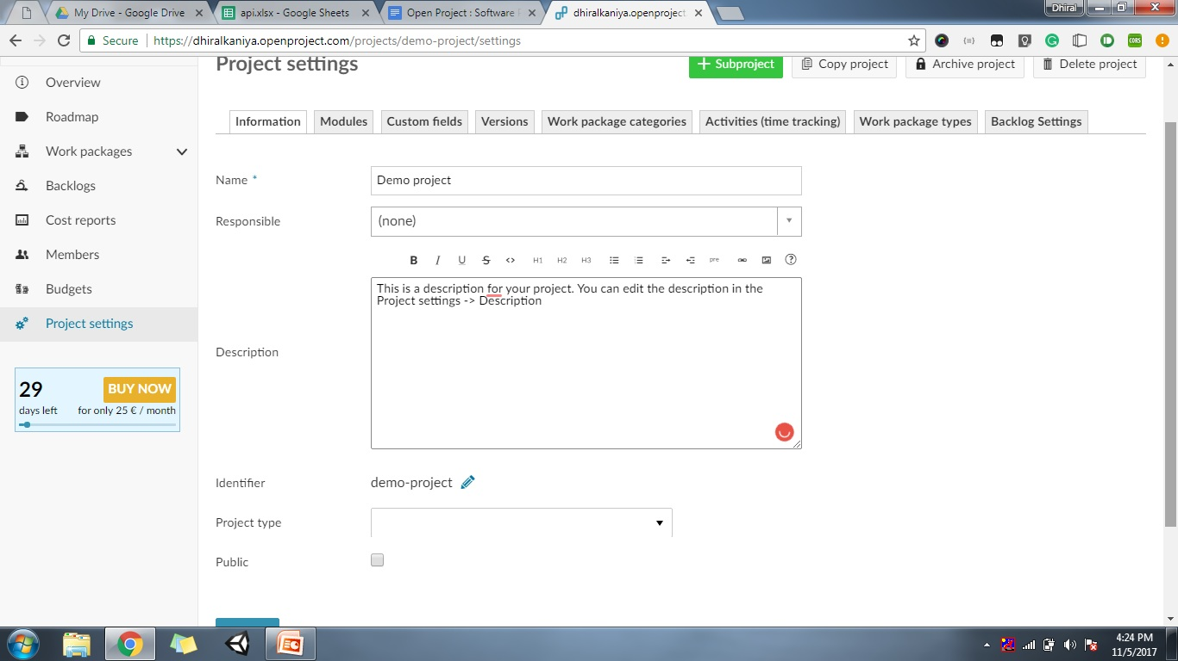
7) Project Setting
Every project can be individually adjusted, with different functionalities being activated or deactivated, differing project members, customized roles and workflows.

Slide 24
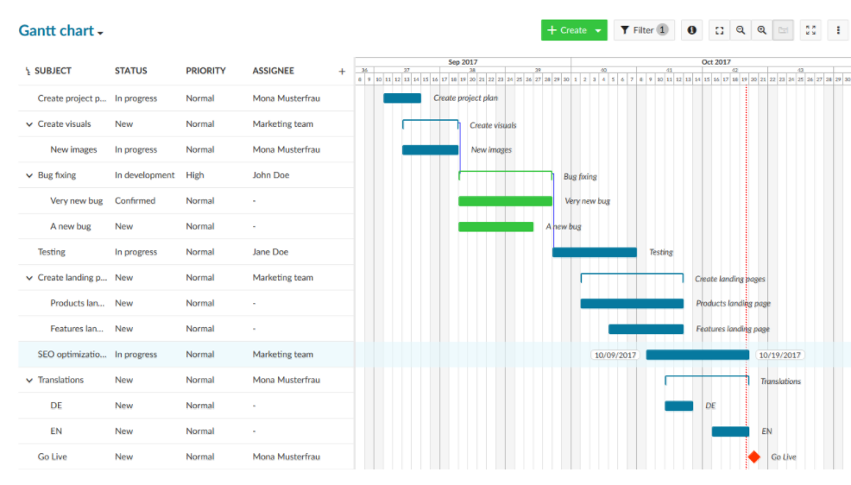
8) Gantt Chart

Slide 25
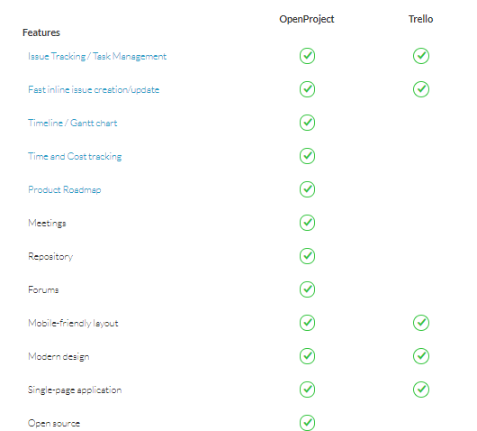
Comparison with Trello:

Slide 26
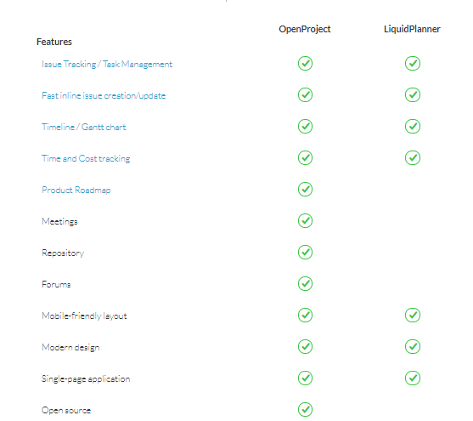
Comparison with LiquidPlanner:

Slide 27
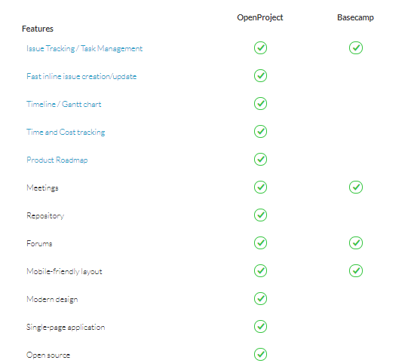
Comparison with Basecamp:

Slide 28
Knowledge area | Open project | Freedcamp
Scope management | It can manage multiple projects at the same time | The software is very well maintained as it is for unlimited user and project as well.
Time management | With OpenProject you can always keep control of the time and costs planned for and spent on the projects. We can also get a time report using a plugin. | Keep track of the team work using calendar
Human resources management | We can assign different roles to people. | Can assign different roles to people and hence manage human resources.
Cost management | Budget chart and cost report present | Their no such feature for cost management .
Communication management | Communication possible via email or feedback | Communication possible via live chats using comments. Also, there is a chat wall for collaborators. The SMS and email used to send notification when change is made.
Risk management | Risk are managed by issue tracking , backlogs, bug tracking | A paid version is available for tracking bugs.
Procurement management | There is no procurement management | There is no procurement management

